Slide 1

A.V.C COLLEGE OF ENGINEERING
IT6811 - PROJECT WORK - VIII Semester
DEPARTMENT OF INFORMATION TECHNOLOGY
Project Title :
Vision-based Mobile Indoor Assistive
Navigation Aid for Blind People
Guided by
Assistant Professor-IT

Slide 2
OBJECTIVE
This paper presents a new holistic vision-based mobile assistive navigation system to help blind and visually impaired people with indoor independent travel.
The system detects dynamic obstacles and adjusts path planning in real-time to improve navigation safety.
We develop an indoor map editor to parse geometric information from architectural models and generate a semantic map consisting of a global 2D traversable grid map layer and context-aware layers.

Slide 3
INTRODUCTION
Independent travel is always a daily challenge to those who are blind or visually impaired.
Intelligent assistive navigation is an emerging research focus for the robotics community to improve the mobility of blind and visually impaired people.
This paper summarizes our research work on novel intelligent situation awareness and navigation aid (ISANA) with an electronic SmartCane prototype.

Slide 4
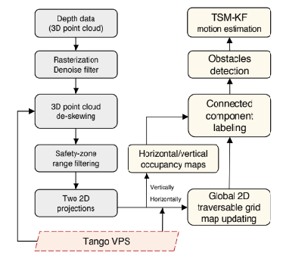
OBJECT DETECTION AND MOTION ESTIMATION FLOW CHART

Slide 5
REQUIREMENTS
Software and Hardware
  ISANA App
  Google Tango
  Google Tango
  CCNY
  SmartCane
  White cane

Slide 6
EXISTING SYSTEM
Vision-based Indoor Assistive Navigation that provide the capabilities to support assistive navigation in real-time.
Approach to customize user experience according to his/her spatial location, the collection of nearby people, hosts, accessible devices, and the changes of all these contextual information over time.
Provide the capabilities to support assistive navigation in real-time.

Slide 7
MODULES
Novel intelligentsituation awareness and navigation aid (ISANA)
CCNY indoor map editor
CCNY SmartCane for robust HMI

Slide 8
PLAN FOR FUTURE WORK
The speech recognition should be improved for robustness in noisy environments;
The audio feedback frequency should be adjustable and customized for different users;
The annotation functionality of adding POI landmarks into the semantic map should be easily accessible for blind users.

Slide 9
REFERENCES
“Vision impairment and blindness: Fact sheet,” World Health
Organization, 2017. [Online]. Available: http://www.who.int/
mediacentre/factsheets/fs282/
A. W. S. Au, C. Feng, S. Valaee, S. Reyes, S. Sorour, S. N. Markowitz, D. Gold, K. Gordon, and M. Eizenman, “Indoor tracking and navigation using received signal strength and compressive sensing on a mobile device,”
E. Xu, Z. Ding, and S. Dasgupta, “Target tracking and mobile sensor
navigation in wireless sensor networks,”

